Slide 1
The Fall Of Babylon
Revelation 18:1-24
chapter discloses the complete collapse of the Roman system

Slide 2
The Cry of An Angel
(18:1-7)
After these things I saw another angel coming down from heaven, having great authority, and the earth was illuminated with his glory.
And he cried mightily with a loud voice, saying, "Babylon the great is fallen, is fallen, and has become a dwelling place of demons, a prison for every foul spirit, and a cage for every unclean and hated bird!
"For all the nations have drunk of the wine of the wrath of her fornication, the kings of the earth have committed fornication with her, and the merchants of the earth have become rich through the abundance of her luxury.“
And I heard another voice from heaven saying, "Come out of her, my people, lest you share in her sins, and lest you receive of her plagues.
"For her sins have reached to heaven, and God has remembered her iniquities.
"Render to her just as she rendered to you, and repay her double according to her works; in the cup which she has mixed, mix double for her.
"In the measure that she glorified herself and lived luxuriously, in the same measure give her torment and sorrow; for she says in her heart, ‘I sit as queen, and am no widow, and will not see sorrow.’

Slide 3
Questions
What did the angel have and what was the effect upon the earth (18:1, 2)?
What was the angel’s message?

Slide 4
The Cry of An Angel
(18:1-7)
“another angel” (v. 1)
  coming down from heaven
  great authority
  message: “Babylon is fallen” (v. 2)
  THEREFORE: Rome’s fall was from heaven

Slide 5
The Cry of An Angel
(18:1-7)
the effect of the earth: illumination (v. 1)
  possible reference to gospel
effect upon Babylon is contrasted (v. 2)
  Rome’s fall is for the earth’s good

Slide 6
Rome’s Description (v. 2)
DWELLING PLACE OF DEMONS
  perhaps a synagogue of Satan (cf. 2:9)
PRISON OF FOUL SPIRITS
  false doctrine entrapped in Rome
  false doctrine; idolatry oft. associated with demons (Deut. 32:17; 2 Chron. 11:15; 1 Tim. 4:1)
EVERY UNCLEAN & HATED BIRD
  abomination (Lev. 11:3)
  feasts on dead things

Slide 7
Explanation for “Why”
(v. 3)
her ungodly influence upon the nations
  when nations ally themselves in immoral practices for gain, God will judge
  may temporarily prosper, but ultimately lose

Slide 8
Admonition to Christians (v. 4, 5)
QUESTION 3:
  Can God’s people fall back into sin? What danger does Revelation 18 identify as existing for such? What is the solution to be safe again?
  Come out of her, my people
    Lest you share in her sins
    Lest you receive her plagues
  Sins reaches to heaven
  God remembers her iniquities

Slide 9
Admonition to Christians (v. 4, 5)
Some Christians were already emboldened to teach compromise (2:14, 15, 20)
  must separate ourselves from the evil in the world or be condemned with the world (2 Cor. 6:14 - 7:1)
  “her sins have reached to heaven” (cf. Gen. 19:13)

Slide 10
Just Punishment (18:6, 7)
Render to her just as she rendered…
Question 4:
  Describe the harlot’s attitude and God’s punishment from 18:6, 7.
  ATTITUDE: pride/selfishness
    Isa. 47:7-11
  JUDGMENT: sow/reap
    reap after you sow
    reap what you sow
    reap more than you sow

Slide 11
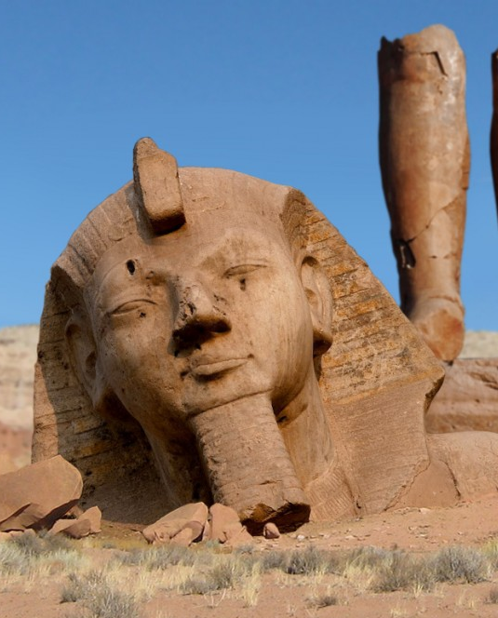
Pride goes before destruction, And a haughty spirit before a fall.
Proverbs 16:18

Slide 12
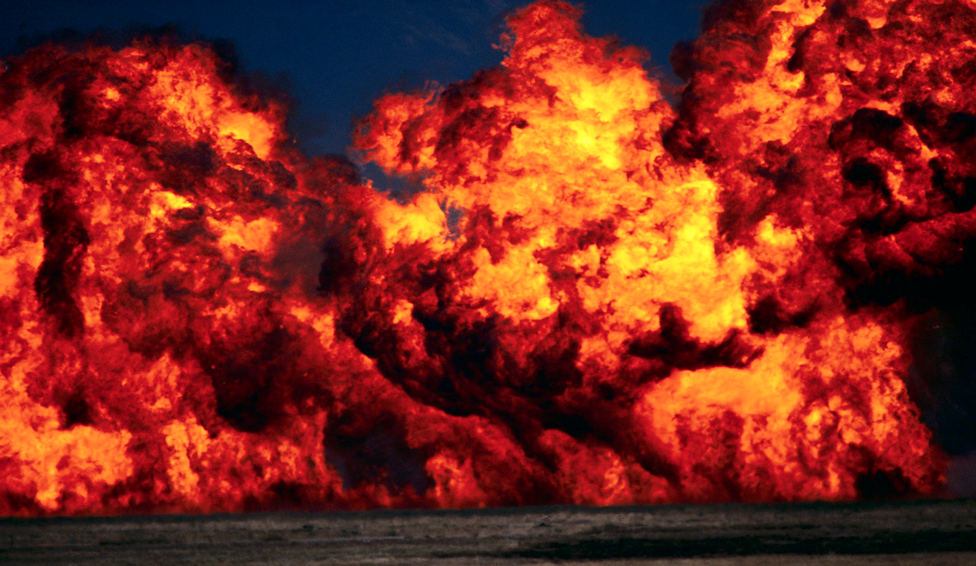
PLAGUES WILL COME IN ONE DAY (18:8-21)
VERSE 8
  DEATH
  MOURNING
  FAMINE
  UTTERLY BURNED WITH FIRE (fig. of her power being burned up)

Slide 13
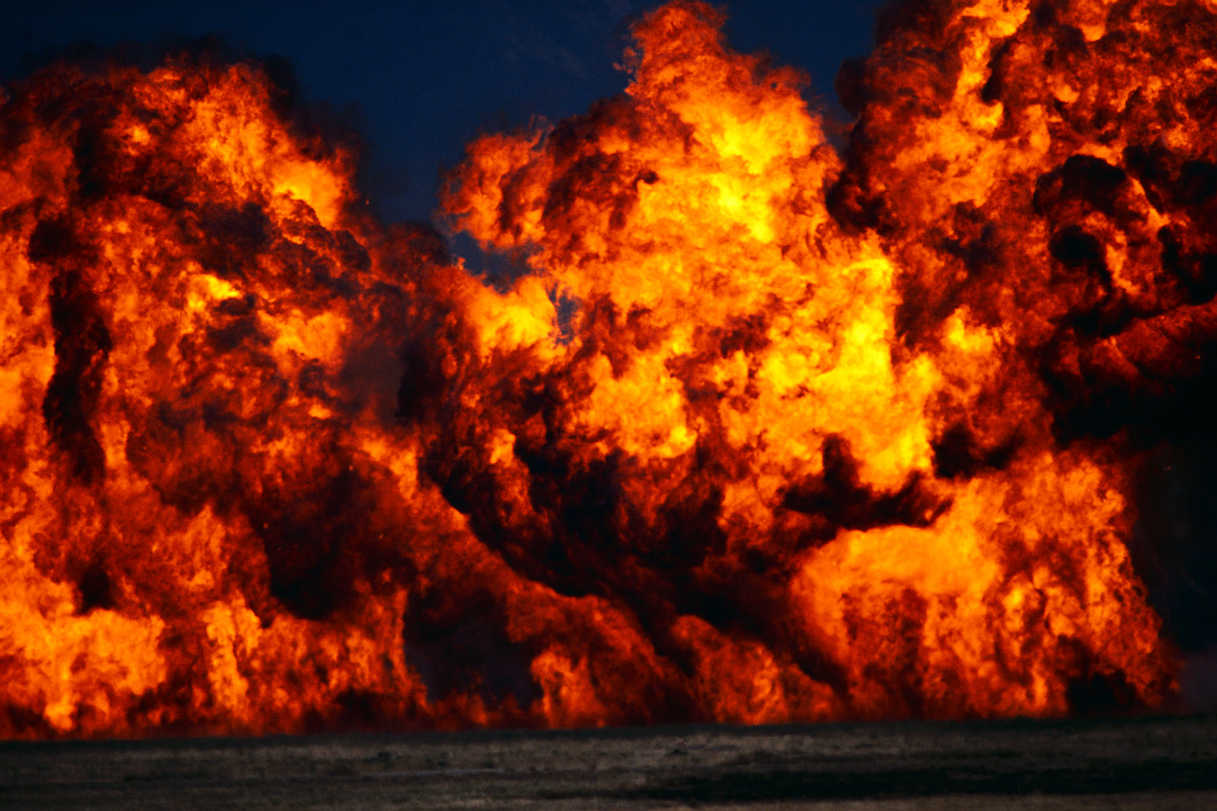
“burned with fire”
“Verily, Rome was never completely destroyed as a city. It has had a continuous history of more than twenty-five hundred years, and present day Rome is a modern city built upon and around the ancient city. Some buildings and monuments which were contemporary at the time Revelation was written still stand in Rome today. . . .”

Slide 14
“burned with fire”
“. . .However, the magnificence and power of the Rome of John’s day was brought to nothing. Rome fell from its position as the world’s leading city of commerce and wealth and as the capital of a world empire whose religious life centered upon pagan god-Caesar worship. In the fourth century the capital of the empire was moved to Constantinople;. . .”

Slide 15
“burned with fire”
“. . .invasions came from barbaric tribes of the north; and finally, the empire was no more after A.D. 476. The power and authority of Rome were utterly destroyed; in fact, its population of more than a million people in John’s day declined to only about 20,00 in the Middle Ages.”
Robert Harkrider

Slide 16
THE FRAGILITY OF NATIONS
GERMANY
FORMER SOVIET UNION
IRAQ
USA 9/11

Slide 17
QUESTION 5
What three groups mourned over the fall of Babylon and why were they sorrowful?
18:9-19

Slide 18
1) KINGS (18:9, 10)
MOURN BECAUSE THEY FALL WITH HER
  THEY HAD AUTHORITY FOR “ONE HOUR” (17:12)
  YET, ROME WAS JUDGED IN “ONE HOUR” (cf. 18:17, 19)

Slide 19
2) MERCHANTS (18:11-16)
WHY DO THEY MOURN?
  economy plummeted
    no one buys their merchandise
AFFECTION FOR ROME WAS BASED ON PROFIT NOT PATRIOTISM

Slide 20

LIVING LESSON:
When nations view man’s economy as being more important than man’s character, they fall into the same trap as all fallen nations of old

Slide 21
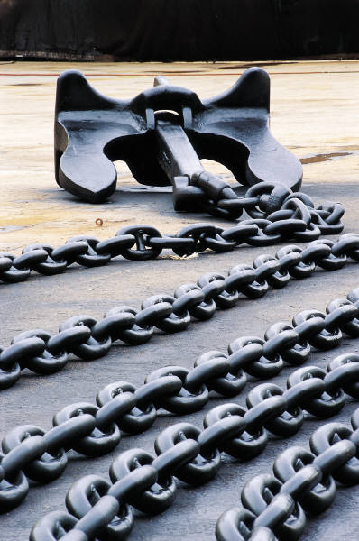
3) MARITIME TRADE WORKERS (18:17-19)
Mourned over Rome’s fall because of lack of revenue
When no one buys cargo, the shipping industry fails
Wealth is the most desired good to people worshiping the god of this age

Slide 22
GOD’S PEOPLE REJOICE (18:20)
A contrast from the three former groups
Soured economy affects wicked and righteous alike

Slide 23
GOD’S PEOPLE REJOICE (18:20)
The death of Caesar-worship would be definite grounds for rejoicing
This happiness is not over fallen people, but over the end of an anti-Christian system (v. 24)

Slide 24
LIKE A MILLSTONE
(18:21-24)
QUESTION 7:
  How is the millstone in verse 21 to be applied and understood regarding Babylon?

Slide 25
LIKE A MILLSTONE
(18:21-24)
THE PURPOSE OF THE ANALOGY:
  Rome will never rise again to become a world empire any more than a large stone, after having been cast, could rise up out of the sea

Slide 26
Rome’s Reversal
a city filled with laughter
. . .turned to mourning
a city where progress sounded in the streets
. . .replaced by silence
a city of marriages
. . .now empty

Slide 27
QUESTION 8:
What are the two fundamental reasons given in this chapter for Babylon’s overthrow?

Slide 28
Restating the Reasons
she deceived the nations through sorcery (18:23)
she persecuted the one true religion (18:24; cf. 17:6; 11:7)
  the character of God is what exalts a nation (Prov. 14:34)
  Rome punished godliness and exalted evil

Slide 29
It has been estimated that more than 160 million people died in all the Roman wars.

